Slide 1
Stress and Safety at Work Environment
Lecture # 14

Slide 2
Workplace Stress
Workplace stress is the harmful physical and emotional responses that can happen when there is a conflict between job demands on the employee and the amount of control an employee has over meeting these demands.
In general, the combination of high demands in a job and a low amount of control over the situation can lead to stress.
Stress in the workplace can have many origins or come from one single event.
It can impact on both employees and employers alike.
It is generally believed that some stress is okay (sometimes referred to as “challenge” or “positive stress”) but when stress occurs in amounts that you cannot handle, both mental and physical changes may occur.

Slide 3

Workplace Stress and Sources Human Reaction To Workplace Stress
Measurement of Workplace Stress

Slide 4

Sources of Workplace Stress

Slide 5
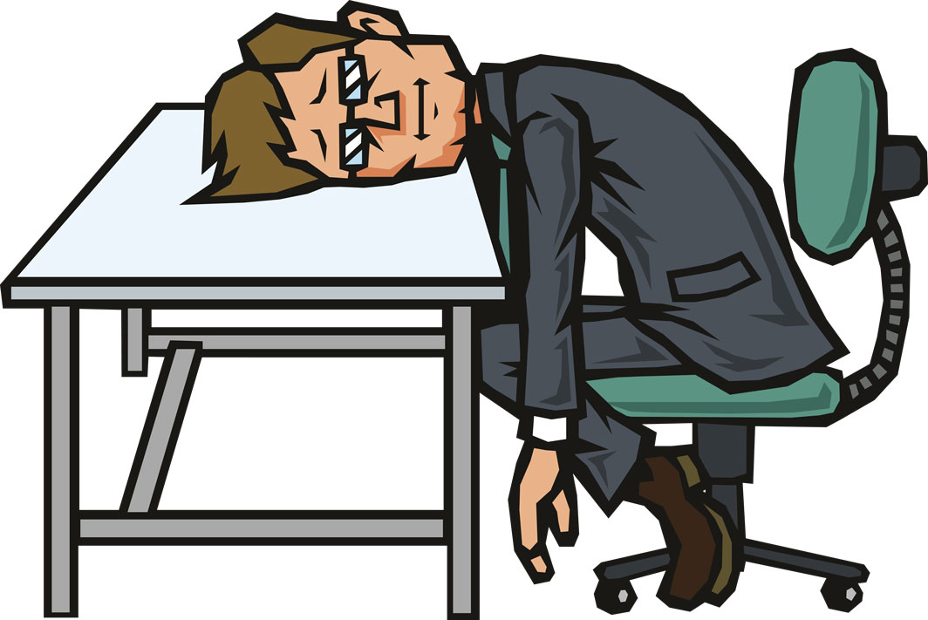
Low Morale
When morale is low, workers often feel powerless which makes them complacent, and productivity suffers.
Some of the most stressful jobs include secretary, waiter, middle manager, police officer, and editor.
Workplace stress arises when professionals have to respond to the demands and timelines of others with little control over events.
Common to these types of careers are feelings of too little authority, unfair labor practices, and inadequate job descriptions.

Slide 6

Management Style
Another factor in stressful work situations is management style.
If a workplace has poor communication and employees are not included in decision-making processes, workers do not feel supported by their coworkers and employers.
In addition, a lack of family-friendly policies can lead to increased stress due to effects on work-life balance.

Slide 7

Job Responsibilities
This includes heavy workload, infrequent breaks, long hours and shifts, unnecessary routine tasks, ignoring workers’ skills, and more.
When job expectations are uncertain or conflicting, employees feel they have too much responsibility and too many “hats to wear.”

Slide 8

Career Concerns
Another factor in workplace stress is career concerns such as job insecurity or lack of advancement opportunities.
Rapid changes with little or no learning curve are also identified by the CDC as problematic.

Slide 9
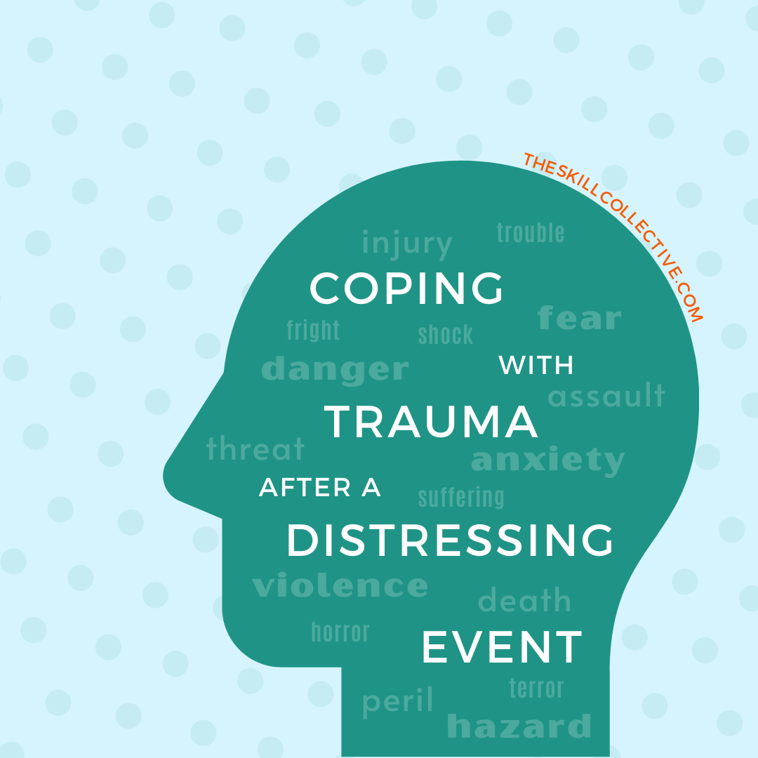
Traumatic Events
It is true that some jobs are more dangerous than others.
Many criminal justice professionals, firefighters, first responders, and military personnel experience stressful situations and personal risk every day.
Occasionally, this can cause ordinary responsibilities to become difficult.
For that reason, positions such as those listed above are particularly stressful.

Slide 10

Work Environment
Most of the previous causes of workplace stress are emotional; however, a subpar work environment can create physical stress as well.
Whether this is related to noise, lack of privacy, poor temperature control, or inadequate facilities, work setting is critical in lowering workplace stress.

Slide 11
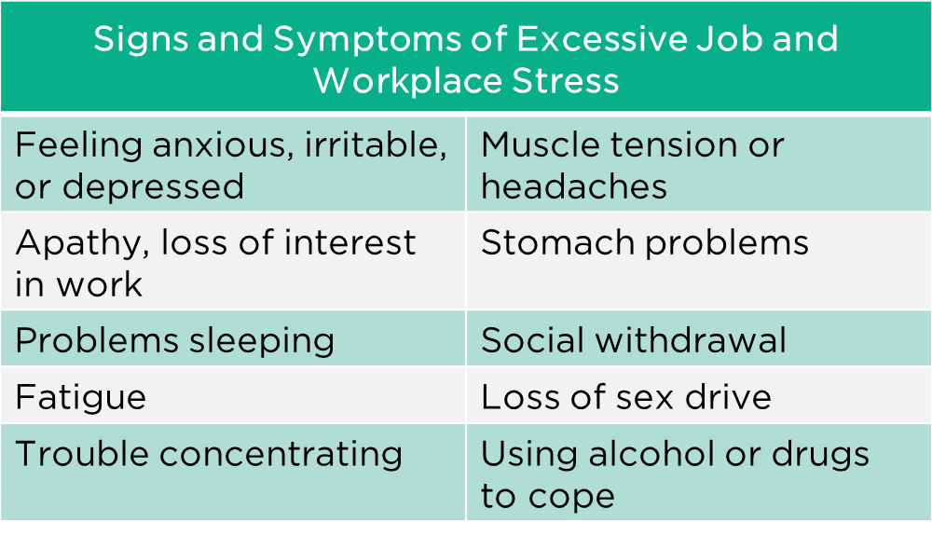

Slide 12
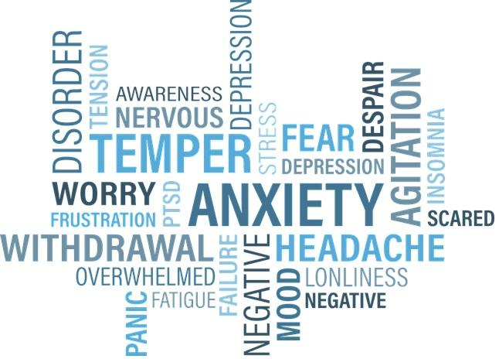
Short Term Symptoms of Stress
Headaches
High blood pressure
Indigestion
Insomnia
Irritability
Depression
Short attention span
Loss of appetite
Procrastination
Increased use of alcohol and drugs
Poor job performance

Slide 13
Long Term Negative Effects of Stress
Cardiovascular disease: Psychologically demanding jobs that give employers little control over work processes increase the risk of cardiovascular disease, according to the Encyclopedia of Occupational Health and Safety.
Musculoskeletal disorders: It is believed that stress increases the risk of back and upper-extremity musculoskeletal disorders.
Psychological disorders: Several studies suggest that differences in mental health problems for various occupations are due to differences in job stress levels. Such problems include depression and burnout.
Workplace injury: There is also a concern that stressful working conditions can interfere with safety practices and increase the risk of injury at work.
Suicide, cancer, ulcers, and immune function: Some studies suggest that there is a relationship between workplace stress and these health problems, but more research is needed to draw firm conclusions.

Slide 14
Solutions for Managing Workplace Stressors
A healthy workplace is defined as one that has low rates of illness, injury, and disability in its workforce while remaining competitive in the marketplace. Some characteristics of such organizations include:
Recognition of employees for good work performance.
Opportunities for career development.
An organizational culture that values the individual worker.
Management actions that are consistent with organizational values.

Slide 15
Leadership Strategies for Stress Reduction
Ensuring that workload is aligned with employee capabilities and resources.
Designing jobs that provide meaning and opportunities for workers to succeed.
Clearly defining roles and responsibilities.
Providing opportunities for professional development and participation in decision-making.
Improving communication concerning the overall health of the company.
Providing opportunities for social interaction among workers.
Establishing schedules that make sense for demands and responsibilities outside of work (work-life balance).

Slide 16
Measurement of Workplace Stress
Job stress was measured on five subscales:
Employee empowerment
Role overload
Role ambiguity
Rule violation
Job hazard.

